Slide 1
Virtual STEM Summer CAMP 2020 POP IN PL
Cobb County School District
Norton Park Elementary School

Slide 3
Agenda
Behind the scenes work- Gretchen
Boxes and Delivery (MapQuest Route App)- Krystal
Community Speakers- Gretchen
Parent/ Student Showcase End of Camp Celebration- Ashley
Flipgrid- Shannon
Tracks- Jenny, Krystal, Ashley, Shanon
Zoom links and monitor- Jenny
Morning Rally- Gretchen
Q & A

Slide 4
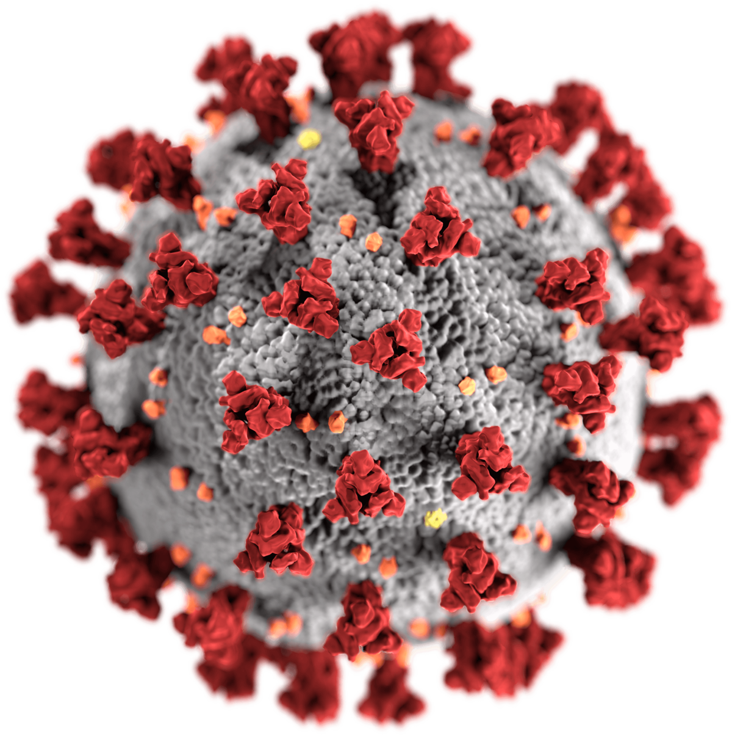
Virtual STEM Camp Idea
First STEM Camp in 2018- 2019 School Year
COVID-19
Virtual STEM Camp was born!

Slide 5
Youtube Camp Video https://www.youtube.com/watch?v=rNEx2qVLyE0

Slide 6
Logistics
Teacher promoted to students at the end of the school year through their online teaching platforms.
Teacher collaboration was completed through Teams, Shared Excel Sheet, Zoom Calls, Text, Email, One in person teacher meet up to sort materials social distant with mask on outside.
Students used a Microsoft form to register.
https://www.canva.com

Slide 7
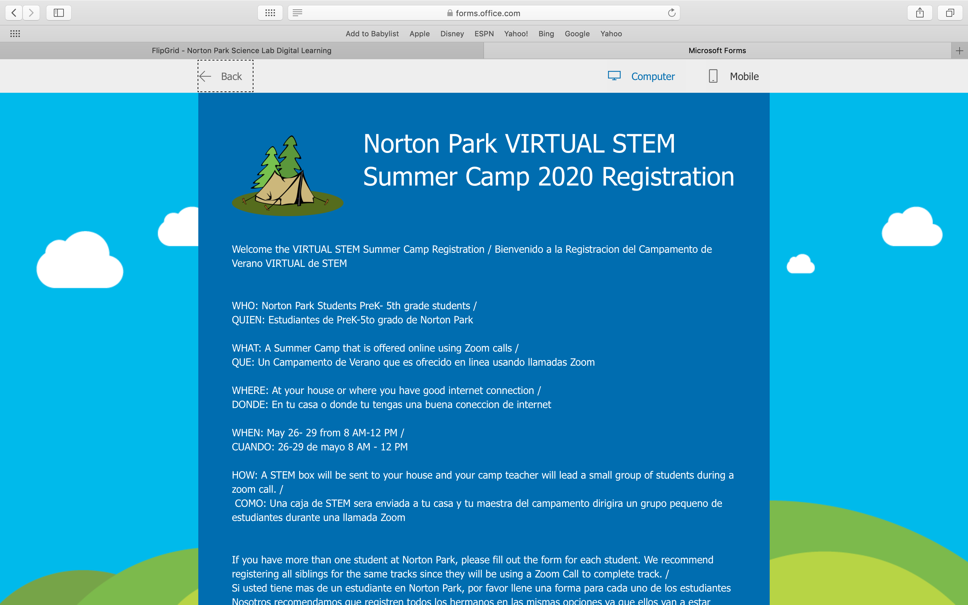
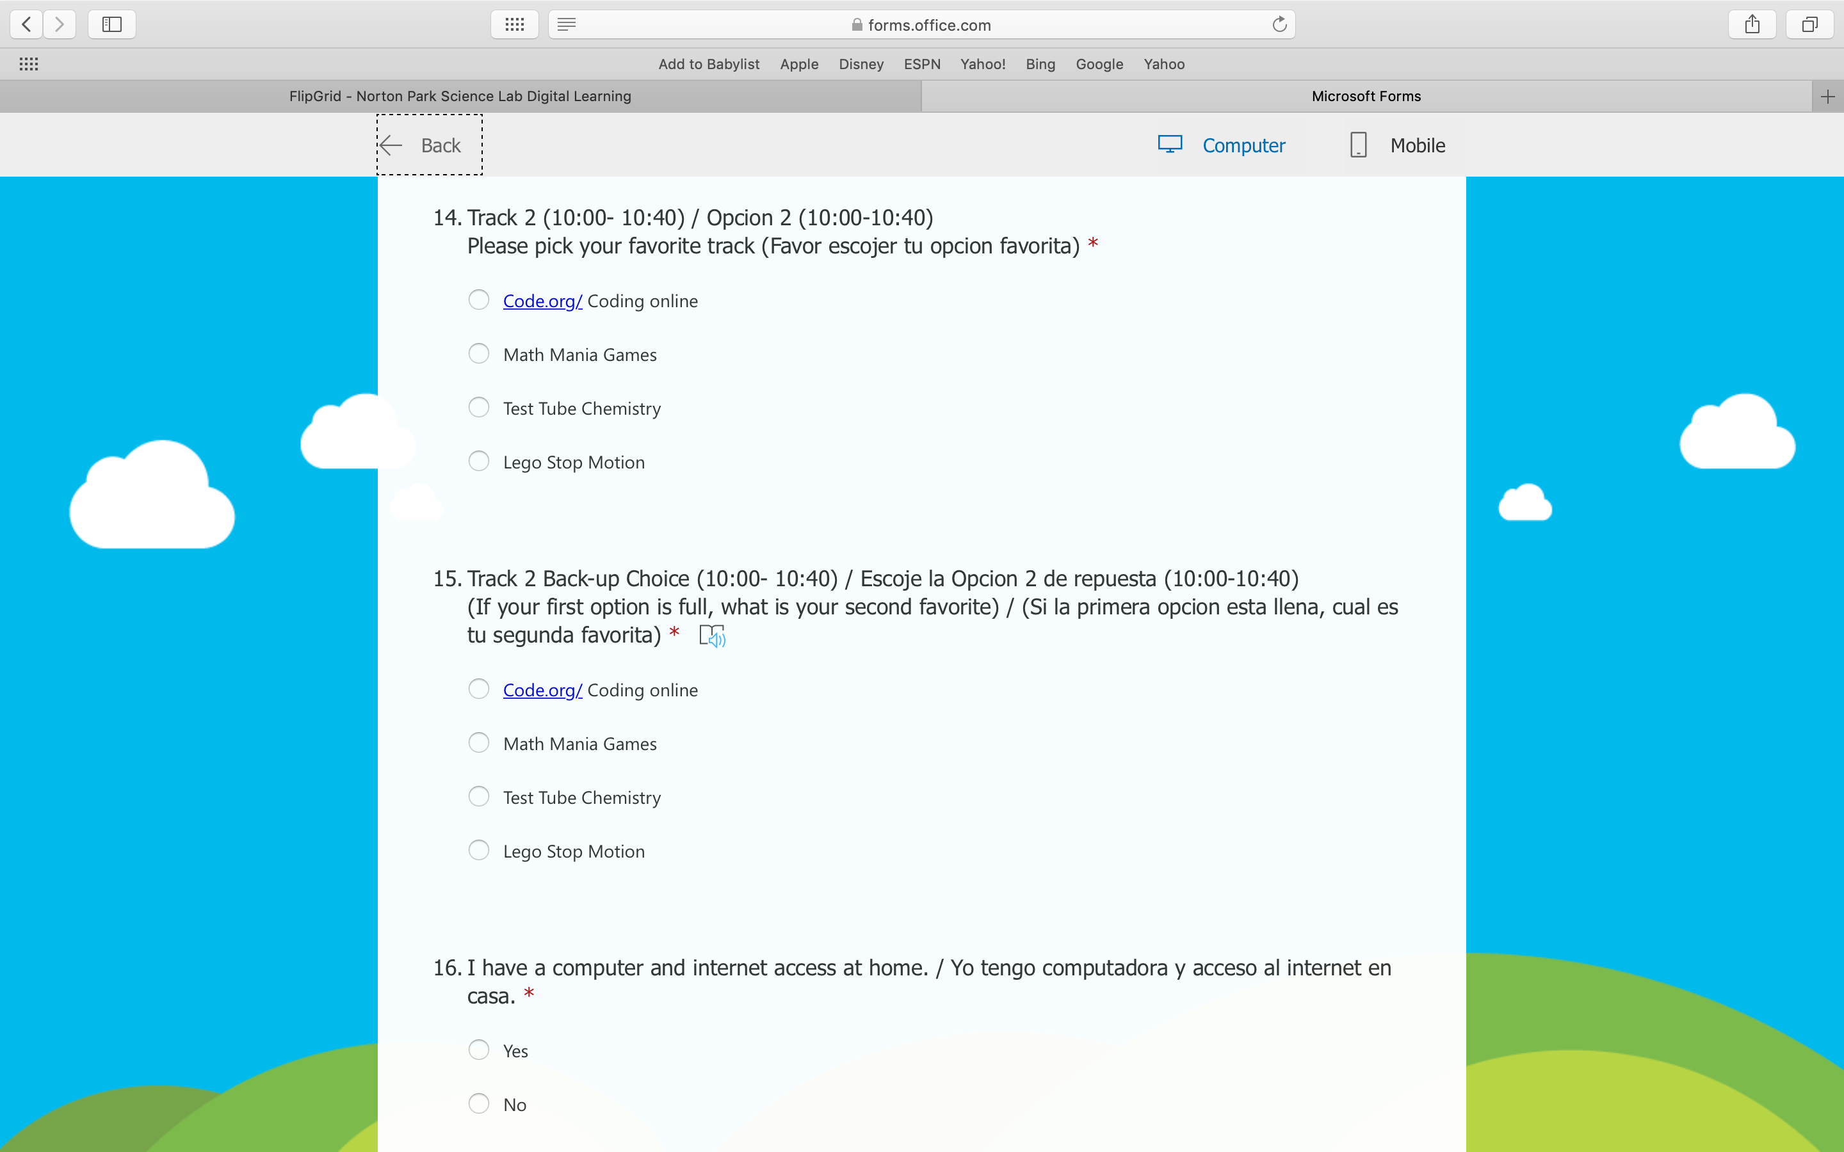
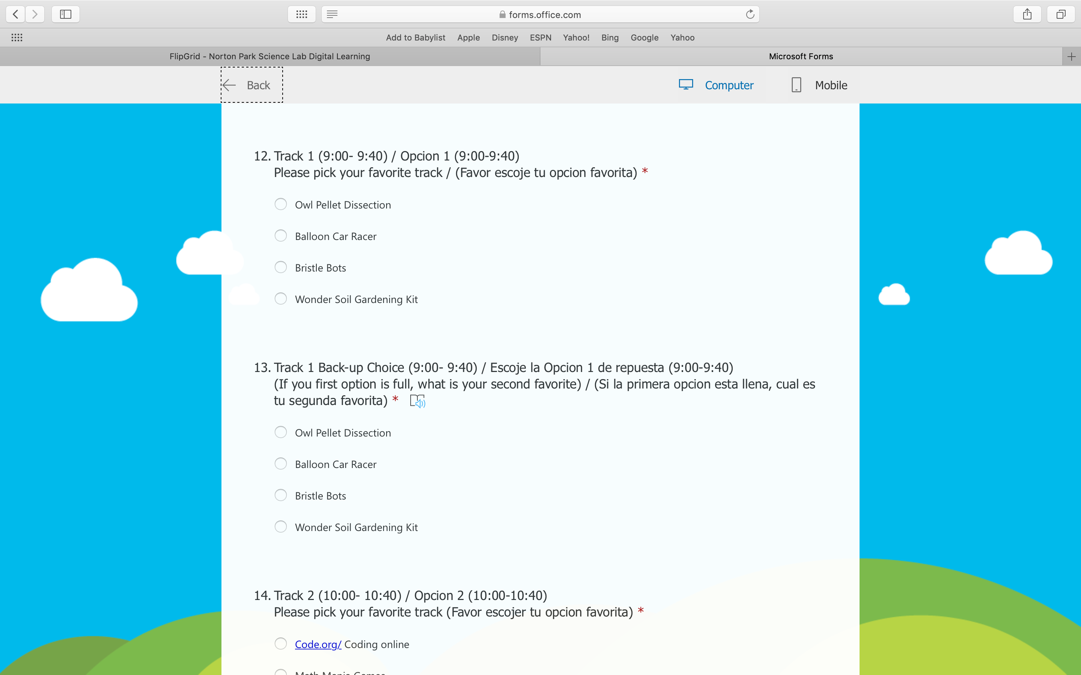
Https://tinyurl.com/virtualstemcamp

Slide 8
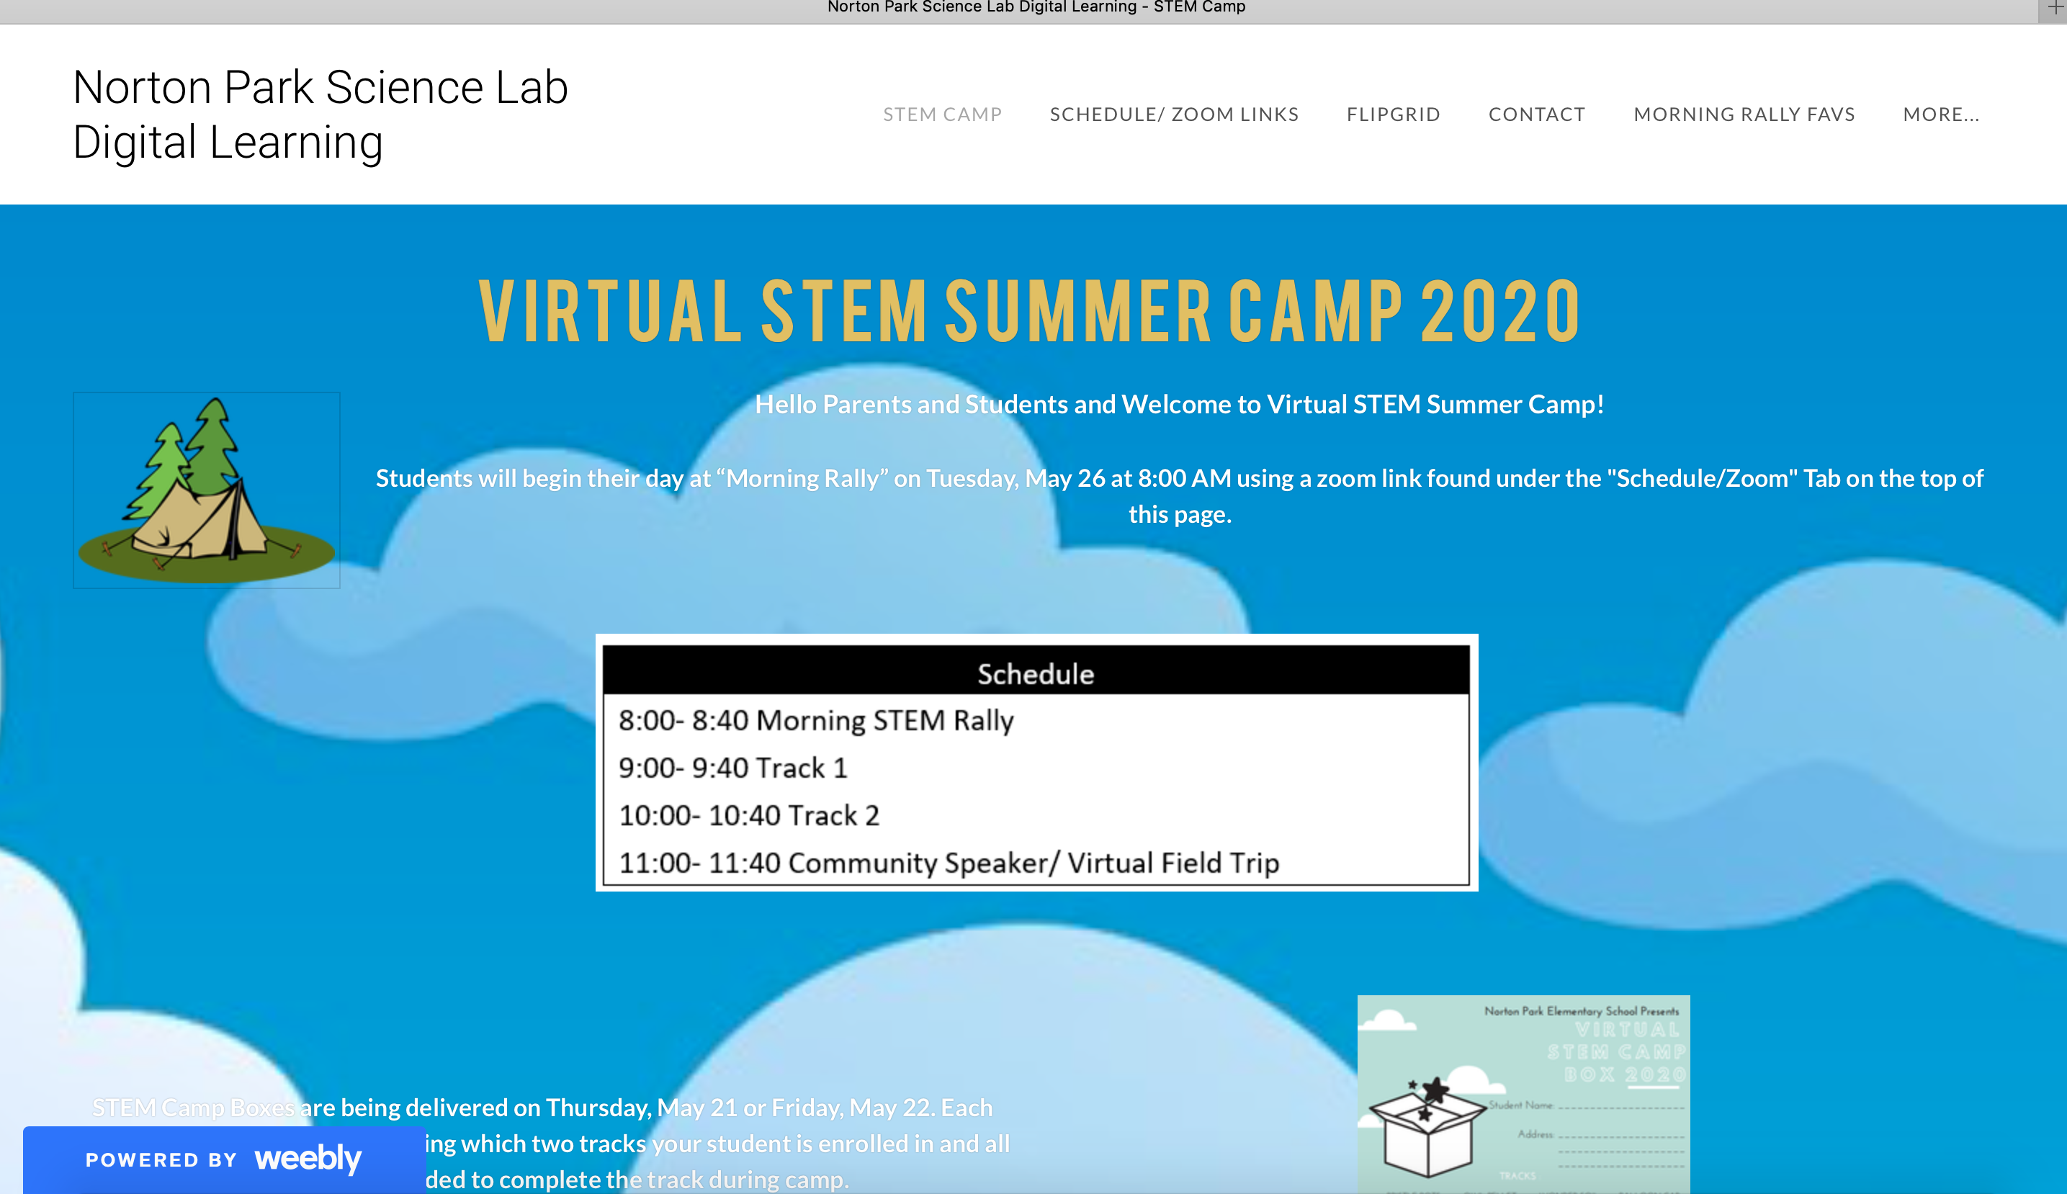
Camp Website Weebly
http://npksciencelabonline.weebly.com

Slide 9
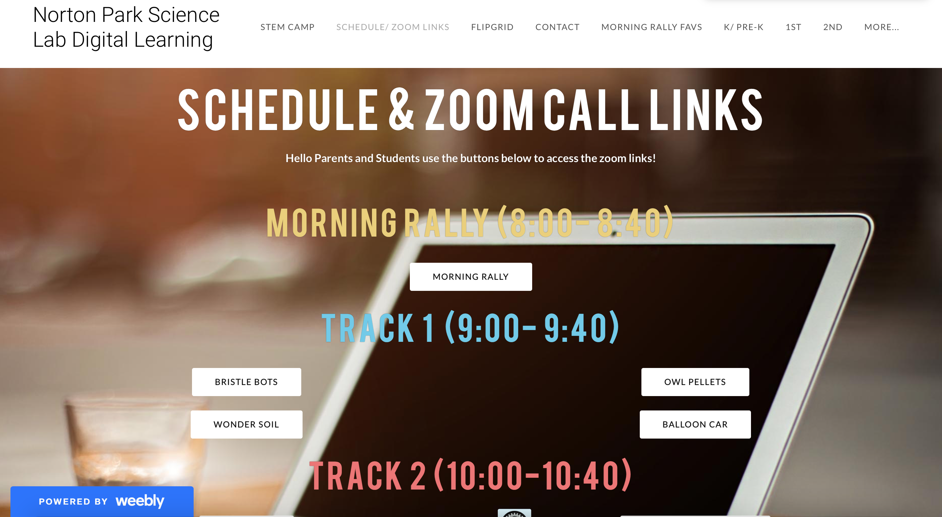
Zoom Links and Monitor
Posting morning rally, each track, and speakers zoom link on the camp blog
Instead of showing the whole link address, change those links into a single subject for easy access
The password is set up the same for each zoom link
Model how to find the link on the first few days
Talk about the zoom rules ( mute the mic, only put questions in the chat box...)
When student signs into the meeting, they have to make sure they are signing in with their student name
During the meeting, have another teacher as your cohost

Slide 11
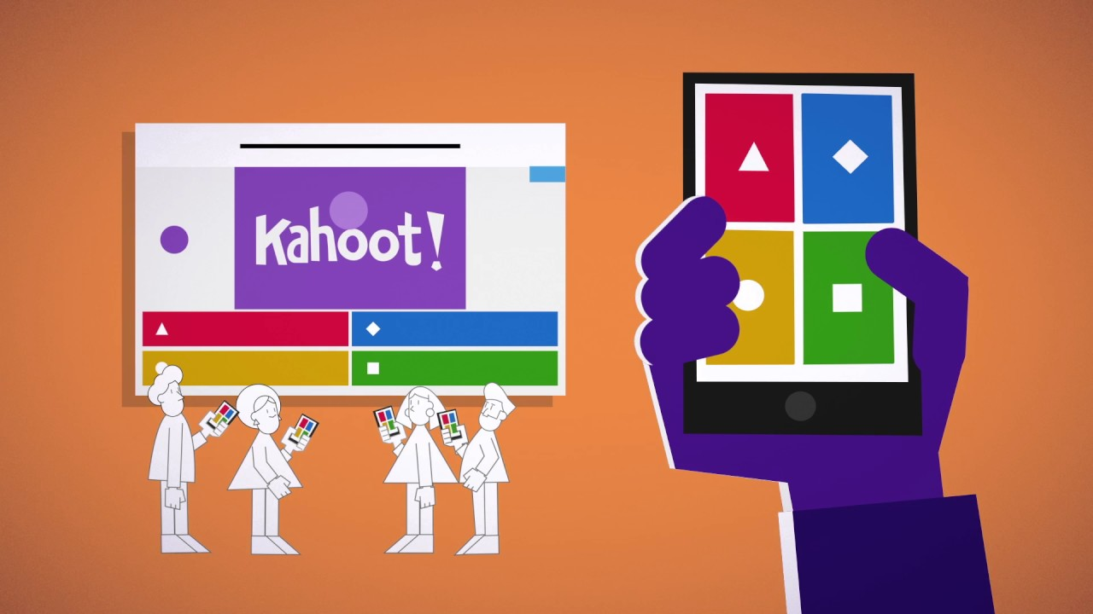
MORNING RALLY
40 minutes
Welcome all students for the day
Movement with Go Noodle Science songs
Teacher Introduction
Zoom Rules
Special Information for the day
Highlight the Guest Speakers Occupation
Kahoot Game focused around Guest Speaker

Slide 12
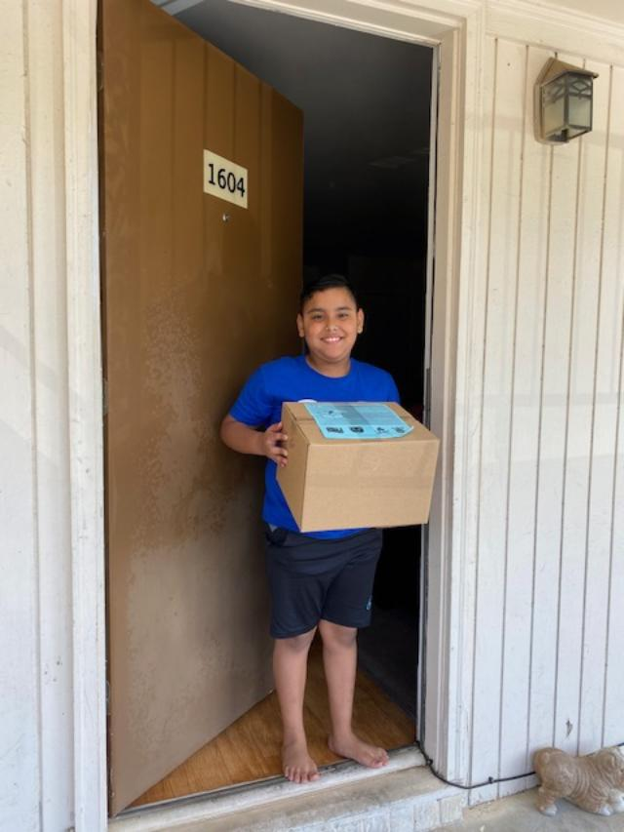
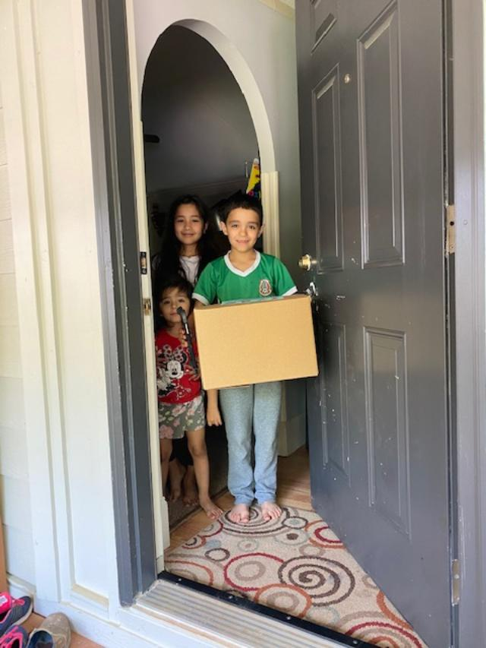
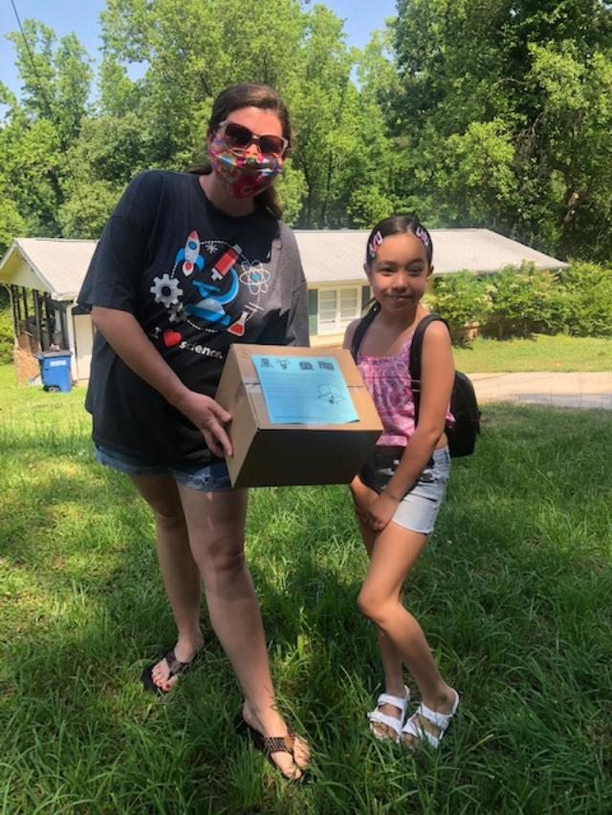
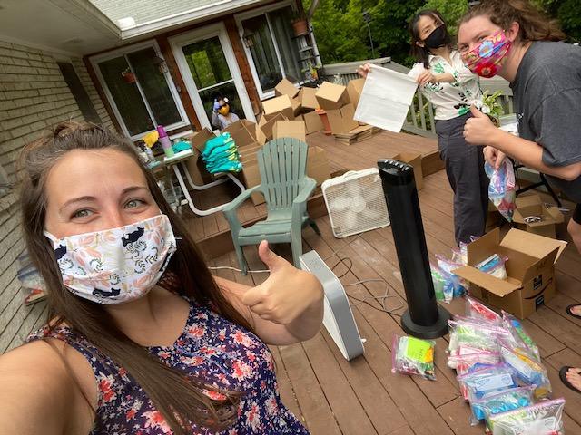
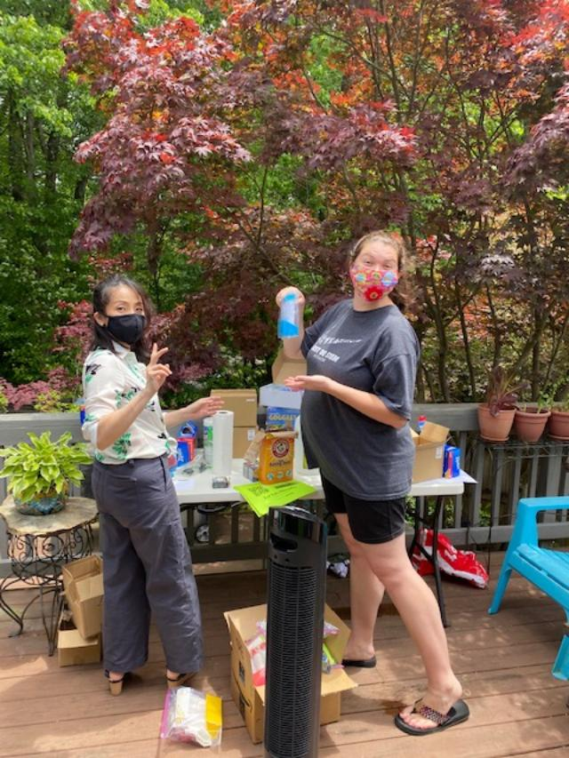
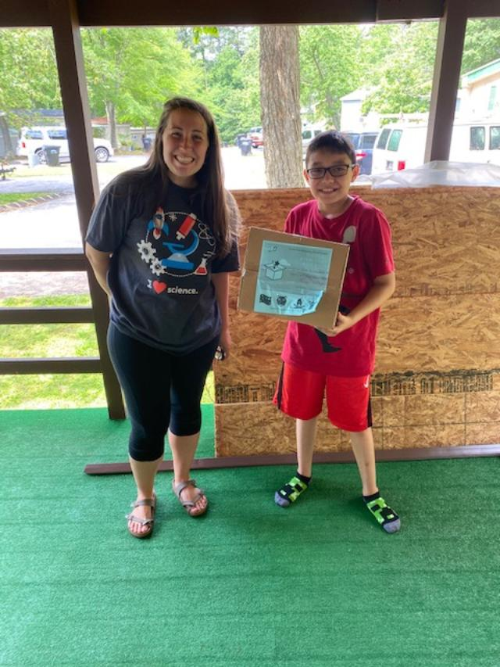
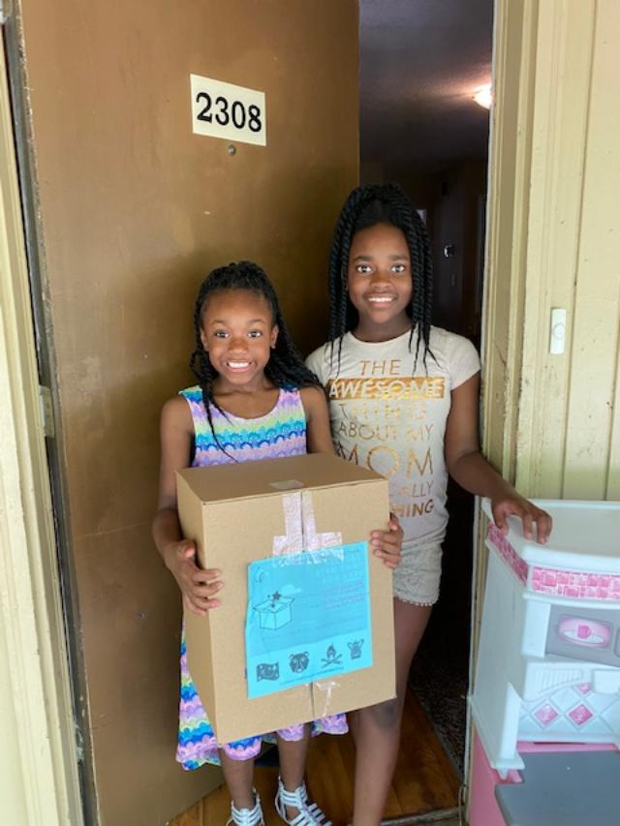
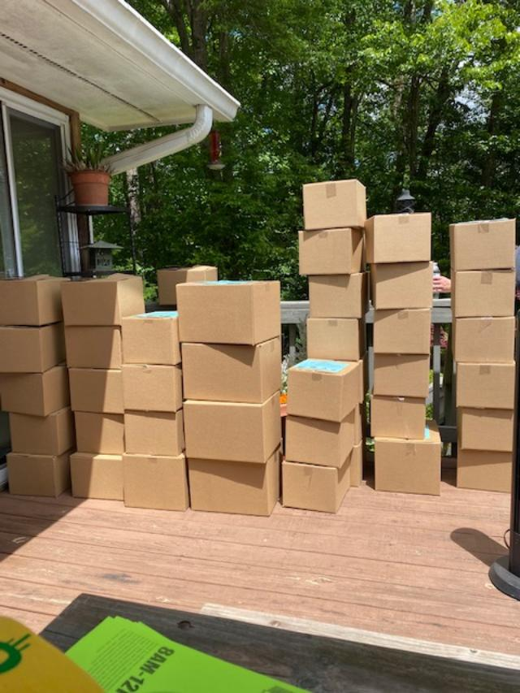
Boxes and Deliveries The supplies for the camp were ordered and delivered to Gretchen's house. The camp teachers met and socially distanced to boxed up the supplies for each family. Each box contained the supplies for the 2 tracks the students were in, any needed graphic organizers and mini journals, information about logging on to Zoom, t-shirt and student certificates.
https://www.mapquest.com/routeplanner
We used the Mapquest Route Planner to align the deliveries so that we would be able to minimize our delivery time. The boxes were delivered a few days before the camp started and the students were told not to open until camp started.

Slide 13
Tracks at virtual stem camp

Slide 14
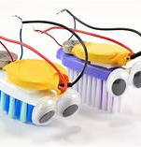
Tracks Bristle Bot
Be familiar with the kit (battery box, replace toothbrush, check the connection, shoe box)
Have students use the engineer design process
If a student has problem with their robot, let the students identify the problem, and have the groups to come up ideas to solve it
What's in the Bristle Bot Bristle Bot kit
Art bot

Slide 15
Tracks Code.Org
Set up student acoount before the class
Have students' "secret picture" on the power point to save time
After the introduction, put the students in the breakout room
Teacher can see student's progress at the dashboard. It will show you student's work, also there is a teacher view, it will give you an example solution
Code.org My Coding
This Photo by Unknown Author is licensed under CC BY-SA

Slide 16
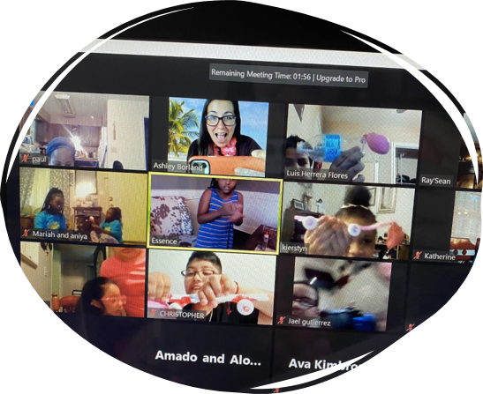
Tracks: Balloon Car Racer
Students were given the following materials in their STEM Box: balloons, straws, mints, rubber bands, and popsicle sticks
Each day we followed a different part of the Engineering Design Process
Tuesday: Ask/ Imagine
Wednesday: Plan
Thursday: Create
Friday: Improve
TAPE/GLUE?
Balloon Car Test Flipgrid

Slide 17
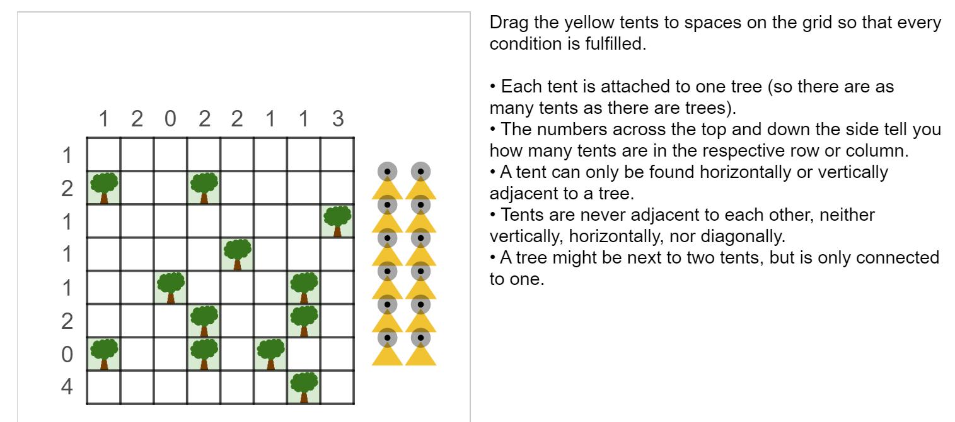
Tracks: Math Mania
Logical Puzzles
Set Game
Desmos
Brain Teasers
Kahoot

Slide 18
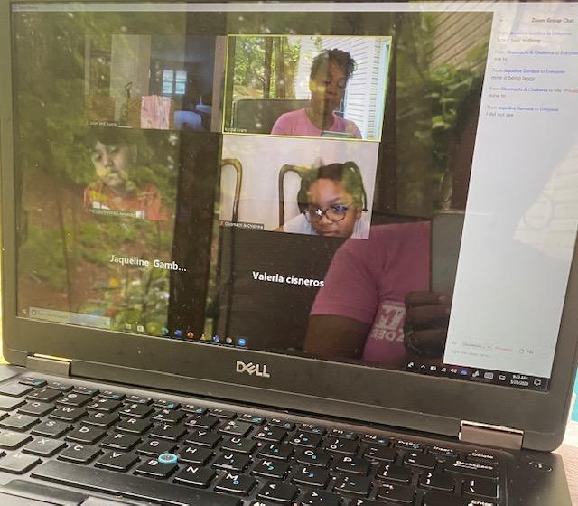
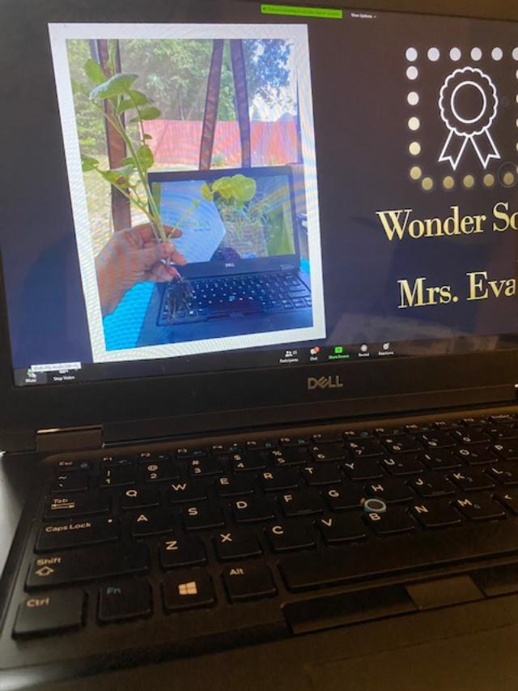
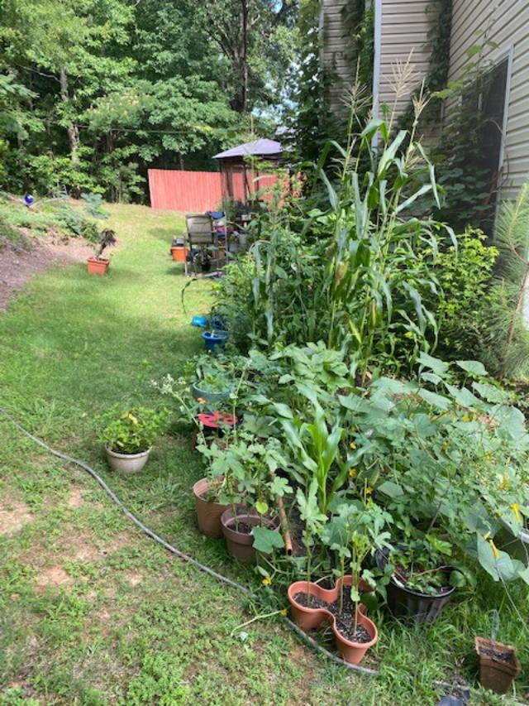
Wonder Soil
In this track the students learned about soil, planting a garden, & growing plants. This a short overview of the camp.
Day 1: Imagine: How do seeds become plants? 1. Show my garden and talk about planting. 2. Have the students design the front cover of their plant journal. 3. Have the students plant their first seeds.
Day 2: Plan/Create: How do you plan for a garden? 1. Show the video from seed to plant (SciShow kids). 2. Discuss organisms and animals who live in the garden. How they may help or hurt plants. 3. Students will write in their journals.
Day 3: Test/Plant: What things do plants need to survive? 1. We will discuss what is requires to successfully grow a garden. 2. The students will plant their second seeds. 3. The students will write in their journals.
Day 4: Improve/ What’s next: 1. We will watch a video on caring for plants. 2. We will discuss how the students will keep a journal of how their plants grow. They will create a video about their experience as new farmers.
I sometimes used 2 devices to show the kids my garden and how to plant. At the end of the week, I gave the students the link to my YouTube channel so they could get more tips on gardening throughout the summer. YouTube Channel: Krystal Evans- Garden Queen
1Replanting Flowers Journey's Flipgrid

Slide 19
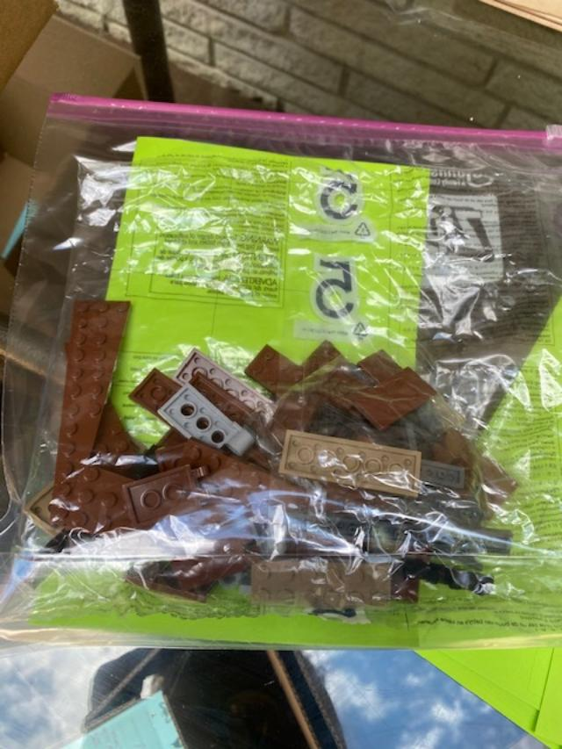
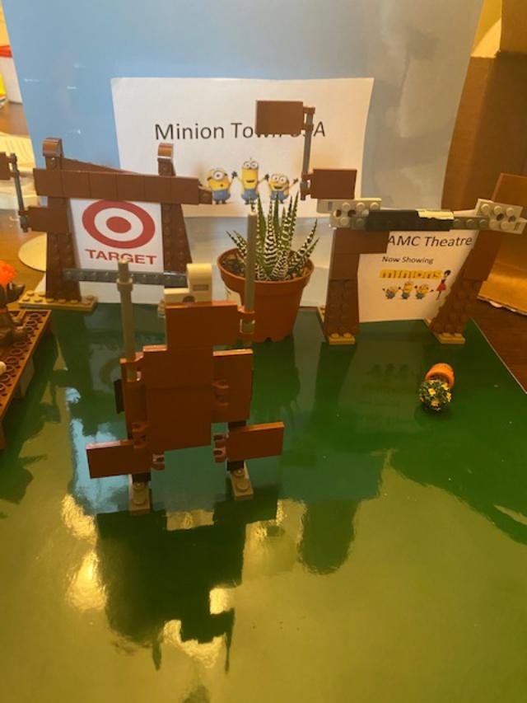
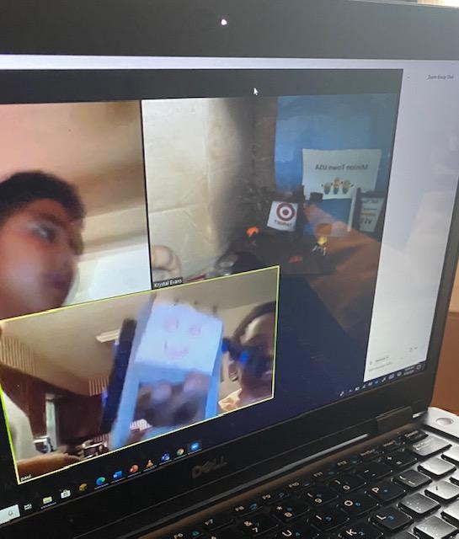
Lego STop-Motion
The students used the iMotion App to create their short films
Day 1: Imagine: Discuss Legos and Stop Motion – 1. Show a video of stop motion (youtube) 2. Show my Stop Motion video 3. Have the students discuss their ideas and decide on a title and start the planning sheet.
Day 2: Plan/Create: Discuss how to start a Stop Motion. 1. video of how to begin (show video). 2. Show my planning sheet. 3. Students will start their planning sheet and take their pictures.
Day 3: Test: Discuss some issues that might come with the plan. 2. Students review the plan and take more pictures. 3. Work on the Stop Motion video.
Day 4: Improve and Test Again: The students will make any improvements. The students will share their Stop Motion videos.
Lego Video

Slide 20
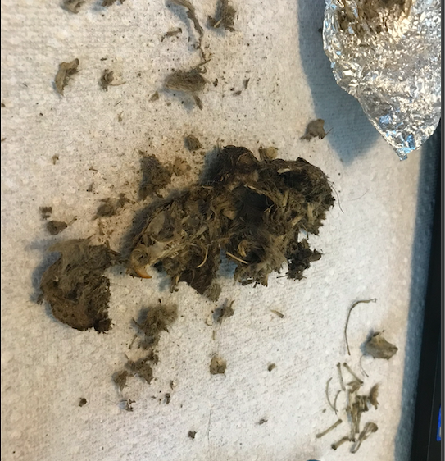
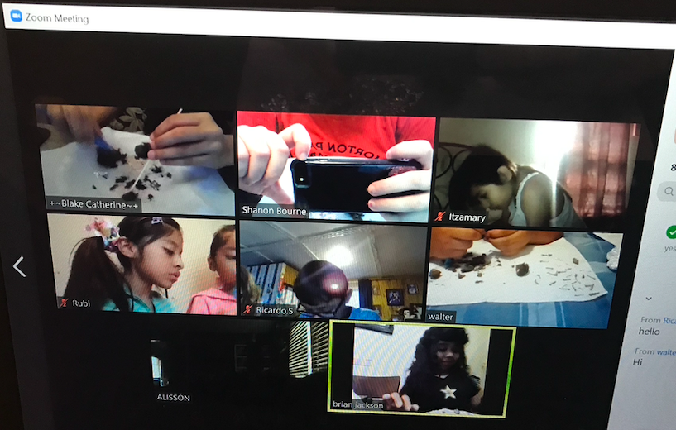
Track: Owl Pellet Dissection
Day 1 – Intro to Track: Review Science safety procedures. Look at materials and allow students to guess what we will be doing with the materials this week. Show video about Barn Owls https://youtu.be/XFSCsyPHw6c
Day 2 – Learn Watch this video about Owl's diets https://youtu.be/nL0e6HMx1NI then watch the 30 second video about owl pellet dissection on Kidwing.com. When done, dissect your own pellet at https://kidwings.com/virtual-pellet/index2.html
Day 3 – Experiment share digital booklet and begin on page 37 https://issuu.com/wolfcenter/docs/obdk-pelletguide_5x8_issuu-091916/32 and begin to dissect pellets
Day 4 – Experiment using the pellets contents, try to identify the food source by using the bone ID charts located on pages 40-45 of the pellet guide. Students may try to glue their bones down to white or black paper and see if they can reconstruction their animal's skeleton

Slide 21
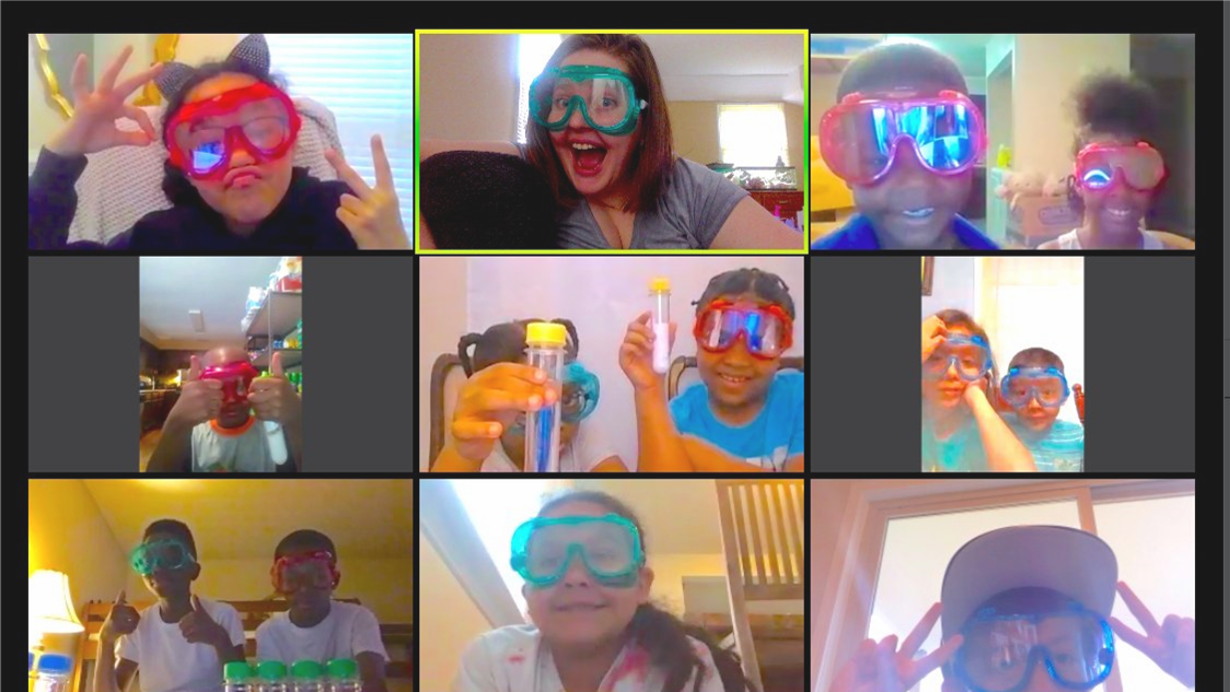
Track: Test Tube Chemistry
Day 1 - Review Science safety procedures using Brainpop video and then playing a game I created on Kahoot. Look at materials and allow students to guess what we will be doing with the materials this week.
Day 2 – Baking Soda and Vinegar. Explore chemical reactions by watching Brainpop video. Students will make a hypothesis about what they think will happen when we mix the two ingredients together. Students will test their hypothesis using different amounts of the materials to see if they can get their balloon to blow up.
Day 3 - Walking Water - Students will fill 2 test tubes with water and add 5-10 drops of food coloring to each tube (leaving one empty test tube between the two tubes with water) Next, students will fold dry paper towels length wise into 1 inch wide stripes. Students will fold the paper towels in half and put one side in a test tube with food coloring and the other side in the middle empty test tube (repeat for 2nd color). Students will make predictions about what they think will happen. Observe and record what happened to the water and paper towels.
Day 4 - Diffusion - students will put hot water in 1 tube and cold water in a 2nd tube. Students will hypothesis what they think will happen when they add 1 drop of food coloring to the different tubes. Students will then add 1 drop of food coloring to each tube and see what happens. Students will explain why they think the cold water separates more easily than the hot water.
https://flipgrid.com/s/7fea8e40534f

Slide 22
Community sTEM Speakers
Tuesday | Wednesday | Thursday | Friday
Civil Engineer- Bridge Builder | NASA JPL- Aerospace Engineer (NASA Mars Robots) | Emory Immunologist | CDC Research Biologist- Ticks

Slide 23
Flipgrid and student feedback

Slide 25
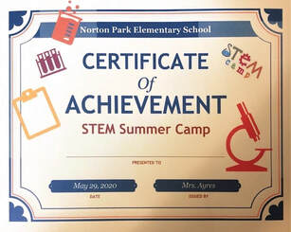
Parent/Student End of Camp Showcase Celebration
All students were given a certificate and STEM t-shirt in their Camp Box
After camp on Friday, parents and students were invited to a showcase
Celebration
Administration recognition
Camp video showcasing student achievement & effort
Specific awards for students in each track

Slide 26
Q & A
Contact: http://npksciencelabonline.weebly.com/contact.html

